Slide 1
Mobilizing Action for Resilient Communities Grant
Claire Ranit
Project Director

Slide 2
Overview
Trauma
ACEs
Resiliency
MARC
MARC in the Columbia River Gorge
Questions?
Notes:
Trauma & adversity are an inherent part of life, no matter where live or work and directly effects staff and people you interact with on a daily basis.

Slide 3
What is “Trauma”
American Academy of Pediatrics
  Healthy Stress
  Tolerable Stress
  Toxic Stress
People experience trauma in situations of toxic stress
  Especially harmful to children because of brain development
Notes:
Explain the different types of stress & that not all stress is bad. Healthy stress is a part of healthy development.
Two people can go through the same experience and for one it can be an event of tolerable stress and the other one of toxic stress.

Slide 4
Adverse Childhood Experiences Study
Southern California 1995 – 1997
17,300 people
Asked 10 questions
Score 0 – 10

Slide 5
ACEs Study Outcomes
ACEs are common
Graded dose response
Influence the risk of over 40 negative health outcomes
Notes:
Changing our approach - what’s wrong with you (only get’s at the symptoms) to what happened to you (get’s at the core of the issue which can address symptoms & true healing)?
Keep in mind that ACEs by no means includes everything that could be considered a traumatic event during childhood & stress and trauma don’t stop at the age of 18.

Slide 6
ACEs & Society
Decreased life expectancy
Economic toll

Slide 7
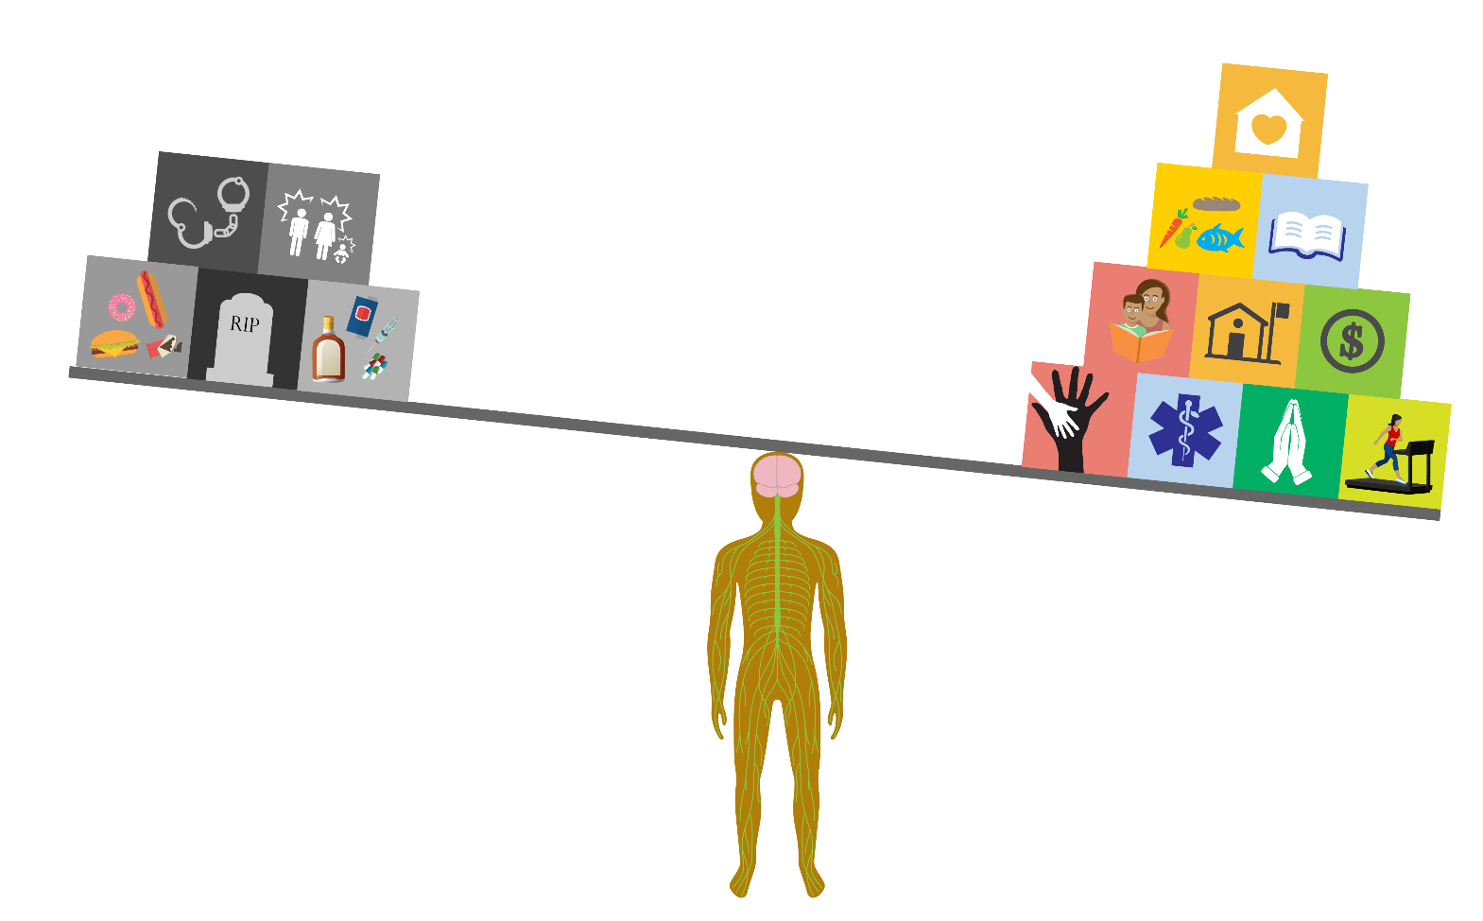
Resiliency
The ability to “bounce back”
  ”Pull yourself up by your bootstraps”
Influenced by:
  Genetic
  Biological
  Environmental factors
This is how we combat the effects of ACEs & trauma.
Anyone can increase their resiliency.
Communities play a huge role in resiliency.
Notes:
Important to remember ACEs scores are not doomsday prophecies or diagnoses, they are an indicator for increased risk.
And the great news is we can do things to combat the effect of ACEs.
And Rotary already helps to do this in the community – building goodwill & better friendships, one aspect of the 4 Way Test, is just one example of how Rotary helps to build resiliency.

Slide 8
Mobilizing Action for Resilient Communities Grant
Movement for just, healthy, & resilient communities.
Spreading knowledge on:
  Adverse Childhood Experiences (ACEs)
  Trauma Theory
  Resiliency
Teaching Trauma Informed ways of interacting.

Slide 9
MARC in the Columbia River Gorge
The Consortium to Create Sanctuary in the Columbia River Gorge
Trauma & Resiliency Summit
  October 20th & 21st, 2016
Trainings in the Sanctuary Model
Workshops in Trauma Informed interaction models
Notes:
Sanctuary as an Organizational Change model - Creating a culture with intention.

Slide 10
The sad news is that ACEs, adversity, and trauma are common.
The good news is we can do something about it!
Notes:
If you have interest in learning more about what I’ve presented on today, please consider attending our free Trauma & Resiliency Summit

Slide 11
Questions?

