Slide 1


From Toxic Stress to Health and Hope: A Framework for Educational Success in the 21st Century
Janice M. Gruendel, Ph.D., M.Ed.
Senior Fellow, Institute for Child Success
February 14, 2018

Slide 2


Slide 3
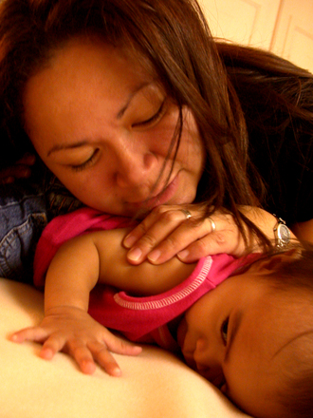
This is not the America we have achieved for our children, yet…

Slide 4

Today, we need to ask two key questions…
First, how can the science of brain development help us to understand challenges to educational success and a healthy, hopeful and productive future for everyone?

Slide 5

Second, how can we move from “fact to act”
AND create something that is better than the best we have done before?

Slide 6
The Arc of (Neuro)Science
Intertwined cognitive and social- emotional development Executive function Self -regulation
Trauma Toxic Stress Adverse Childhood Experiences (ACES)
Poverty Racism & Implicit bias Educational and health inequity Politics…
Mindfulness
Kindness
Health
Hope
Empathy
Resilience
Gruendel, 12.6.17

Slide 7
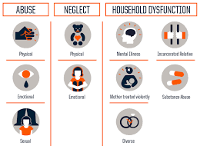
The long arm of early childhood adversity:
The ACE Study
CLICK HERE

Slide 8
When Stress Becomes Toxic
NORMAL STRESS
Getting immunized; Meeting new people; First day at school. First day at work. Presenting big ideas at a public meeting; Kinetic Heights challenge session
TOLERABLE STRESS
Serious Illness; Death of a loved one; Frightening accident; Acrimonious divorce; Persistent discrimination
TOXIC STRESS
Tolerable stress that is not buffered by caring, actively-present adults (or peers). The body’s stress system activates and stays at high levels “like revving a car’s engine for hours every day.” This causes damage at the cellular level of our bodies, impacts our health and mental health, and can be passed from one generation to the next at the genomic level.

Slide 9
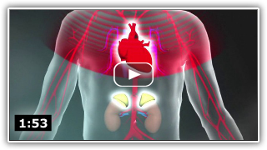
Click Later
Two minutes on how Toxic Stress feels in our bodies
Key Concepts: Toxic Stress. Harvard Center on the Developing Child, Retrieved July 2015

Slide 10

Click Later
An Amazing Ted Talk about ACES by Pediatrician Dr. Nadine Burke-Harris

Slide 11
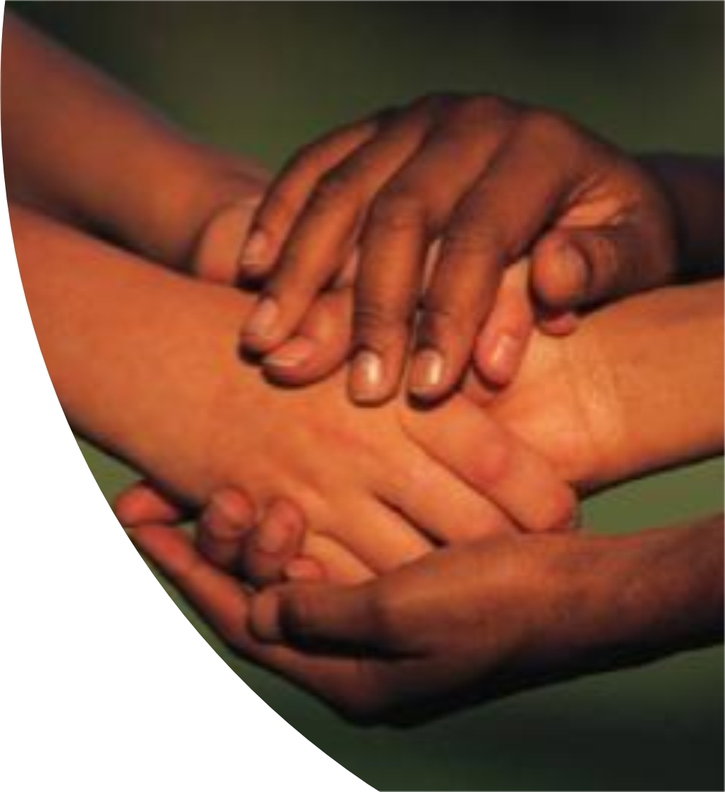
So, what can we do that is better than the best we have done so far?
Learn from the science
Listen to the stories
Intervene early
Focus on the climate we create for learning
Support adults who are buffers against adversity
Partner to build resilience

Slide 12
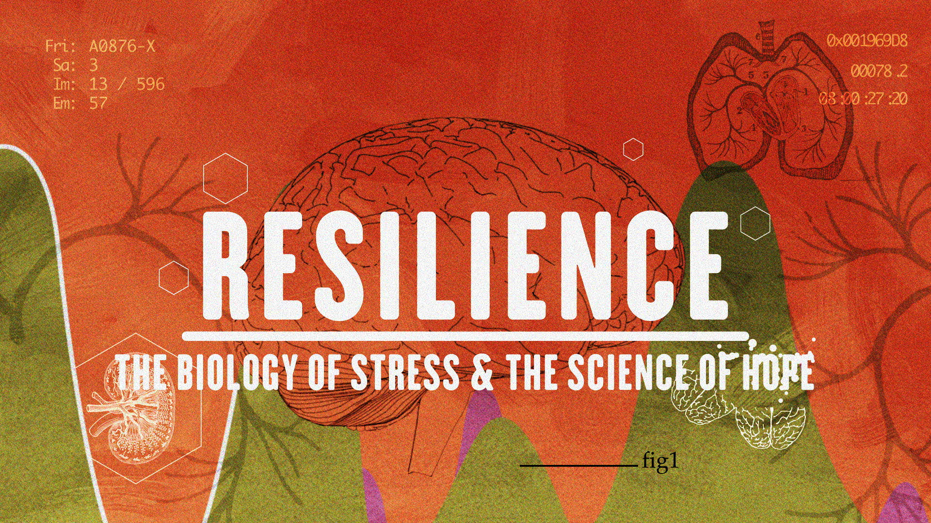
Learn from the Science and build the connection between mind, body and heart
Click Now

Slide 13
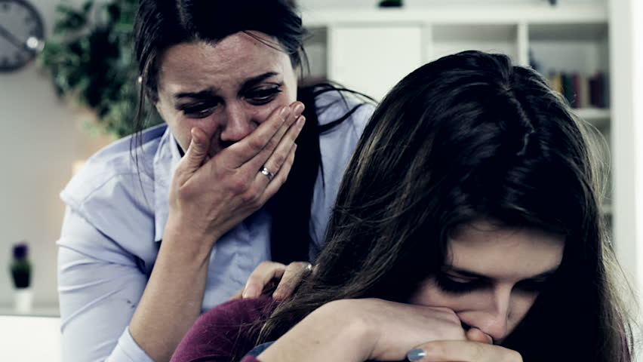

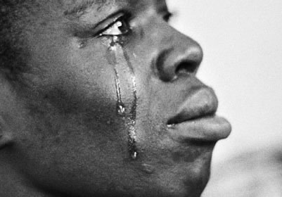

Opioids
Child Abuse or Neglect
Violence. Death. Separation
Trauma.
Disability
Because everybody has a story
…we can listen with humility

Slide 14

We can find kids in need through a real-time Early Warning System -- including data on grades, absences and behavior challenges -- as early as the 3rd grade.

Slide 15
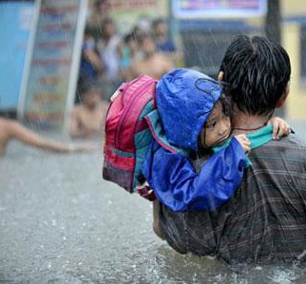
We can support adults who are the buffers against toxic levels of stress in children’s lives…
Parents, across generations
Teachers
Mentors
Coaches
Principals
Because grownups experience stress, too

Slide 16
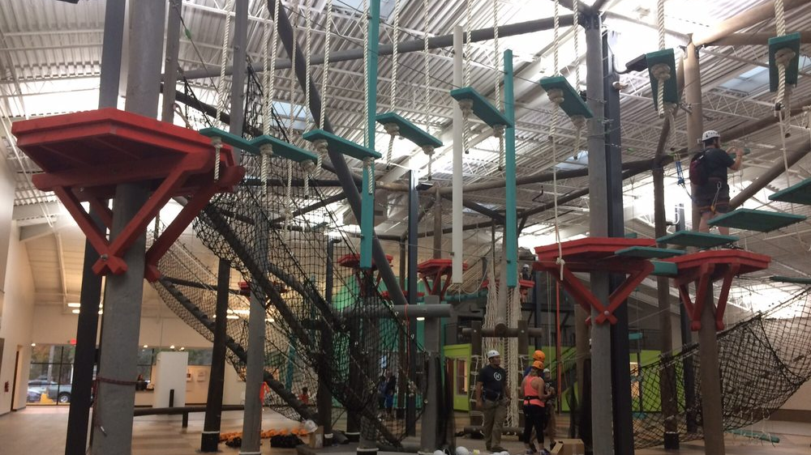
We can build experiences that connect mind, body and heart to support health, SEL and resilience

Slide 17
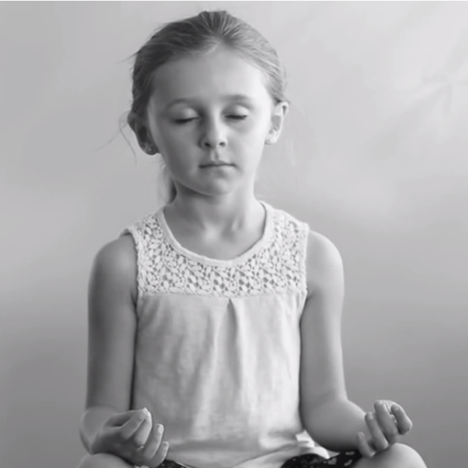

Click Now
We can partner with families and the community to invest in mindfulness and to promote trauma-informed practice and social-emotional learning
Click Later

Slide 18
If we do (some of) these things, we are likely to see…
Behavior incidents Chronic absence School failure Teacher Turnover
Self-efficacy Self-regulation School climate Family engagement Student learning 3rd Grade reading HS graduation

Slide 19

The bottom line
Now that we know -- hope, health and resilience are ours to build, together.
Click Now
Notes:
Just one word on this slide.
We have been searching around for the one image that conveys who we are, what we value and where we are going.
This is the image. For us, it speaks legions to our humanity, and to our belief our strength comes from holding each other close.

Slide 20
Thank you
From all of us at Kinetic Heights and the Institute for Child Success
Janice.Gruendel@aya.yale.edu

