Slide 1
Promoting Social Emotional Inclusion in Education
By Julie Johnson, M. Ed, TVI, ATS, RYT
Natasha Baebler, MAT, E-RYT

Slide 2
The idea of neurodiversity is really a paradigm shift in how we think about kids in special education. Instead of regarding these students as suffering from deficit, disease, or dysfunction, neurodiversity suggests that we speak about their strengths. Neurodiversity urges us to discuss brain diversity using the same kind of discourse that we employ when we talk about biodiversity and cultural diversity.
-ASCD, “Neurodiversity in the Classroom”
-

Slide 3
The Pitfalls of not Addressing Neurodiversity

Slide 4
Educators Feel They Need More Tools
-In our survey of teachers serving students in North St. Louis County and Nationally, teachers overwhelming responded with the following:
78% of respondents were very aware of the outside factors contributing to the student’s ability to learn
100% of respondents said they understood how a student’s behavior at school might be impacted by things they experience outside of school.
44% felt comfortable implementing assistive technology with their students
50% said they didn’t have enough tools to adequately address the need for social emotional inclusion within the school setting

Slide 5
Current Barriers to Addressing Neurodiversity
Little training is available to teachers in this area in a way that doesn’t overwhelm many with content
Teachers say they feel tired and overwhelmed by the day to day need of every child in the classroom
Administrators don’t feel adequately prepared ( with IEP supports in place)

Slide 6
Going Deeper with Neurodiversity
Ways to recognize when a student is demonstrating neurodiverse thinking
Instances that can cause Neurodiversity seen in our educational communities:
-Adverse Childhood Experiences
-Birth Trauma
-Medical Trauma

Slide 7
Our Guiding Framework for Social Emotional Inclusion + Neurodiversity using CASEL’s Guide to Social Emotional Learning
Self-awareness: Know your strengths and limitations, with a well-grounded sense of confidence, optimism, and a “growth mindset.”
Self-management: Effectively manage stress, control impulses, and motivate yourself to set and achieve goals.
Social awareness: Understand the perspectives of others and empathize with them, including those from diverse backgrounds and cultures.
Relationship skills: Communicate clearly, listen well, cooperate with others, resist inappropriate social pressure, negotiate conflict constructively, and seek and offer help when needed.
Responsible decision-making: Make constructive choices about personal behavior and social interactions based on ethical standards, safety, and social norms.

Slide 8
Signs of Social Emotional Learning Needs Among Students with Disabilities
Students prefer to talk to adults over peers
Struggles to self-advocate for needs and wants
Resistant to using accommodation and modifications/Assistive Technology around other students
Challenges managing anxiety
Lacks language around talking about their disability with peers

Slide 9
Adverse Childhood Experiences (ACES)
Observations of students in the FitAbilities program combined with response to the survey reflect a high need to address the reality of the compounding impact of Adverse Childhood Experiences and Visual Impairment on the lives and educational experiences of students in the FitAbilities program.
More on ACES from the ACES Too High Website:
“ACEs” comes from the CDC-Kaiser Adverse Childhood Experiences Study, a groundbreaking public health study that discovered that childhood trauma leads to the adult onset of chronic diseases, depression and other mental illness, violence and being a victim of violence, as well as financial and social problems. The ACE Study has published about 70 research papers since 1998. Hundreds of additional research papers based on the ACE Study have also been published.
The 10 ACEs the researchers measured:
— Physical, sexual and verbal abuse.
— Physical and emotional neglect.
— A family member who is:
depressed or diagnosed with other mental illness;
addicted to alcohol or another substance; divorce
in prison.

Slide 10
Medical Trauma
“Medical traumas are psychological traumas that result from medical diagnosis and/or medical intervention. Threat of serious injury or threat to life due to illness is now encompassed within the DSM definition of psychological trauma. This means that medical patients can be evaluated as having illness-related trauma disorders.”
-Social Work Today
-Medical trauma impacts many students with and without IEPS.
-Medical trauma impacts:
-Students with visual impairments
-students with autism
-Student with cerebral palsy
Who else?

Slide 11
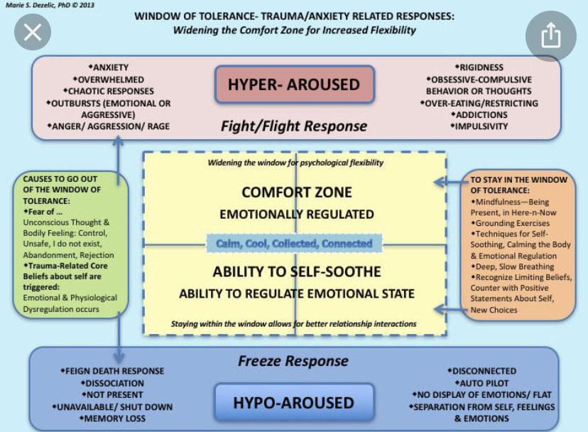
The Window of Tolerance
We are using Dan Siegel’s Window of Tolerance as a support framework to support teachers and students in seeing the way our students might be responding socially through the Window of Tolerance within their educational routine:
:

Slide 12
The Basics of the Window of Tolerance
When a person is within their window of tolerance, it is generally the case that the brain is functioning well and can effectively process stimuli. That person is likely to be able to reflect, think rationally, and make decisions calmly without feeling either overwhelmed or withdrawn.
Read more on the Resource page:
.

Slide 13
The Basics of the Window of Tolerance (continued)
During times of extreme stress, people often experience periods of either hyper- or hypo-arousal.
Hyper-arousal, otherwise known as the fight/flight response, is often characterized by hypervigilance, feelings of anxiety and/or panic, and racing thoughts.
Hypo-arousal, or a freeze response, may cause feelings of emotional numbness, emptiness, or paralysis.

Slide 14
How the Window of Tolerance Impacts Social Emotional Inclusion
Self-awareness: Know your strengths and limitations, with a well-grounded sense of confidence, optimism, and a “growth mindset.”
Self-management: Effectively manage stress, control impulses, and motivate yourself to set and achieve goals.
Social awareness: Understand the perspectives of others and empathize with them, including those from diverse backgrounds and cultures.
Relationship skills: Communicate clearly, listen well, cooperate with others, resist inappropriate social pressure, negotiate conflict constructively, and seek and offer help when needed.
Responsible decision-making: Make constructive choices about personal behavior and social interactions based on ethical standards, safety, and social norms.
Based on the Window of Tolerance Framework, it is very challenging for our students who are facing the adversity of the impact of visual disability, medical and/or diverse childhood experiences to relate to their peers without specific, direct guidance from the trusted adults in their lives.
The teachers in our survey and the Fit Abilities Team are seeing our students struggle the most with the Self-Management and the Relationship Skill Building development within Casel’s Social Emotional Learning Framework

Slide 15
Ways to Use Tools
Multimodal instruction using:
-Yoga
-Mindfulness
-Technology

Slide 16
Using Yoga as Our Primary Tool to Build Resilience
Why Yoga?
Yoga is accessible and adaptable
It’s a tool that can easily be accommodated or modified to meet the needs of the student.
Yoga can be done in small time increments
It can be done in 5-10 minute increments throughout the school day to support social emotional development and overall student learning so students can potentially access their own personal Window of Tolerance.
Yoga can easily be embedded into the classroom with chair yoga or mindfulness practices that promote relationship building
We have potential to support our students ability to maintain their window of tolerance by embedding the skills into their school day with mindfulness practices (mindfulness journaling, play dough, mindful breathing) or doing chair yoga at their desk alongside their peers
Yoga can be used to directly teach academic skills
It can easily be embedded into a teacher’s lesson to promote academic learning and social emotional inclusion

Slide 17
Yoga Activities for the Classroom
-Mudras
-Yoga Spinner
-

Slide 18
Mindfulness
Why Mindfulness?
Mindfulness can support student’s ability to expand their awareness beyond their survival responses within the scope of their normal routine.
Can Improve Emotional Regulation
Students can use mindfulness activities to become self-aware of the names of emotions and how emotions show up in their day to day interactions.
If it’s accessible, teacher can also teach mindful breathing techniques within their educational routine
Has potential to improve social and communication skills
Mindful journaling activities can help students cultivate social emotional language awareness
Can support teaching decision making skills
Mindfulness can also support students plant the seeds for making pos
Easy to adapt into a lesson plan for teachers
Much like yoga, mindfulness can be used in 2-10 minute increments within the classroom with mindful journaling activities, group questions, etc.

Slide 19
Technology
Embedding technology, both educational and assistive, can support a student with neurodiversity in practicing their mindfulness skills using technology
Students with a dedicated assistive technology device also benefit since discerning when it’s appropriate for them to use their device is a mindfulness practice all in one
Combining Technology and mindfulness also teaches all students mindful use of technology

Slide 20
Mindful Use of Technology
Blending mindfulness with technology, we can inclusively teach our students that they have the ability to control technology and not be controlled by it
When students are using the technology within the classroom and/or their own assistive technology, teachers can facilitate a simple mindful practice by simply asking their students a few of the following statements:
Do you ever check in with the state of your mind as you engage with technology?
If you use assistive technology, check in with your mind to consider how you will determine when you will be using your device. What words, sensations, texture or colors might be present for you?
Perhaps every time we hear a beep, it can remind us to check in with our breath, our mind and our bodies.

Slide 21
Inclusion Circles
Circles can be content based
It can provide a space for emotional, social and moral development
It is routine and can facilitate modeling and teaching empathy in both a direct and student lead
approach
Circles promote a trauma-sensitive learning environment for administration, teachers and students
Possible Topics for Inclusion Circles:
Parent/Teacher Involvement
Math Circles
What is Friendship
Gossip
Positive Relationship Building
Mindful Use of Technology Circle
Yoga Circle
Self-Care Circle
Welcome Back after Classroom Absence Circle
Finding Out What Students Already Know (Pre-Test Circle)
-ideas from the book Circle Forward
-
Notes:
Adopted by the International Institutue for Restorative Practices

Slide 22
The Structure of an Inclusion Circle
Group Guidelines (students help come up with rules and are guided by adult)
Check-In
-Giving adults and students and opportunity to check in with where they are
Mindful Moment
1-2 questions to facilitate discussion questions on building positive relationships and teaching empathy (teachers also need to participate in the circle)
3-4 Content/Community Building related questions
Check out-
Ask questions such as:
-What was something you liked about circle today?
-Was there something you didn’t like?
-Is there something you would like to do different next time

Slide 23
Resources
Neurodiversity in the Classroom
http://www.ascd.org/publications/books/113017/chapters/Neurodiversity@-The-New-Diversity.aspx
Neurodiversity: What You Need to Know
https://www.understood.org/en/friends-feelings/empowering-your-child/building-on-strengths/neurodiversity-what-you-need-to-know
Teach, Breathe, Learn: Mindfulness In and Out of the Classroom
by Meena Srivinivasan
Circle Forward: Building Restorative School Community by Carolyn-Watson

Slide 24
Contact
Julie Johnson
Special School District of St. Louis County
jajohnson@ssdmo.org
Natashas Baebler
UD for Yoga
natasha@udforyoga.com

