Slide 1

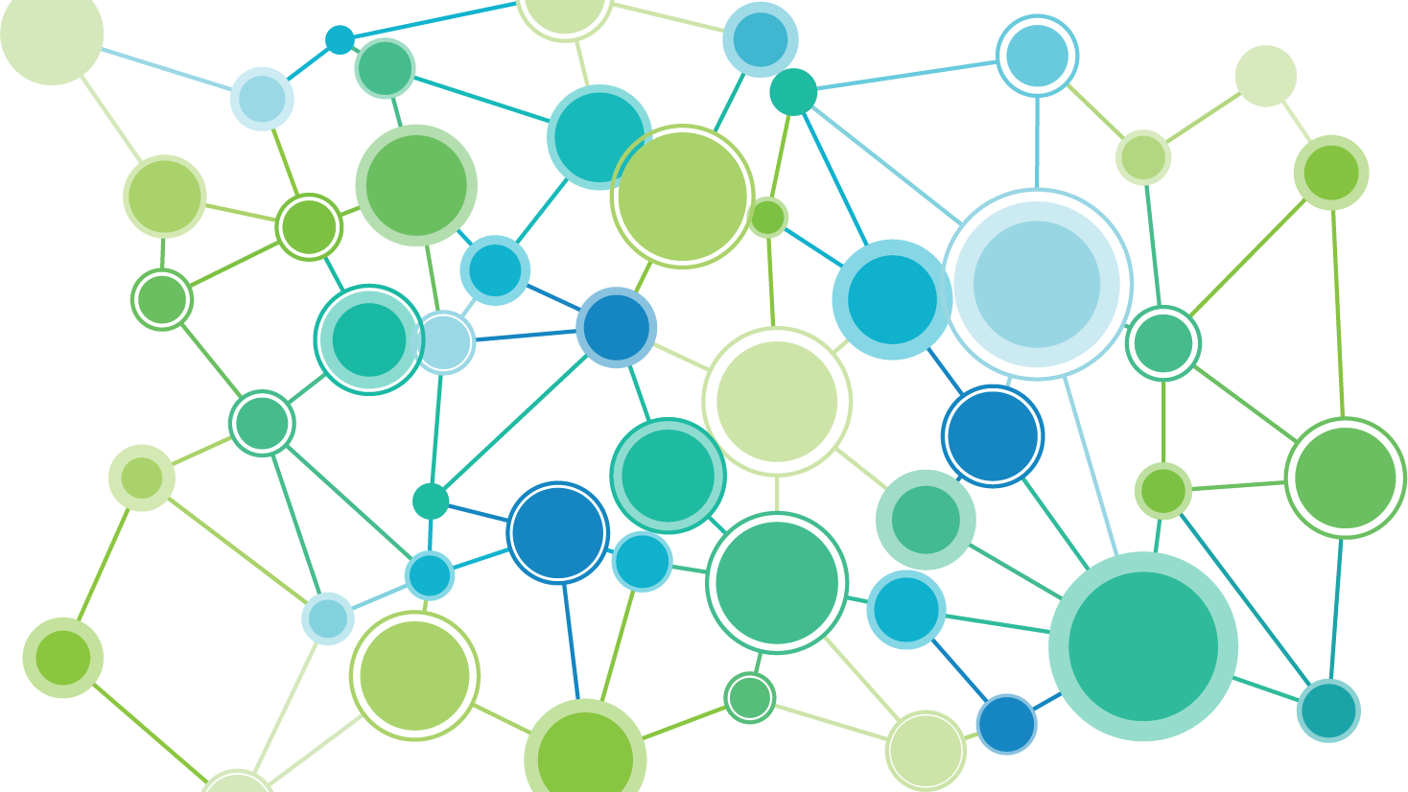

PACEs Connection
Creating a much better normal.

Slide 2

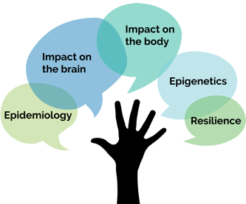
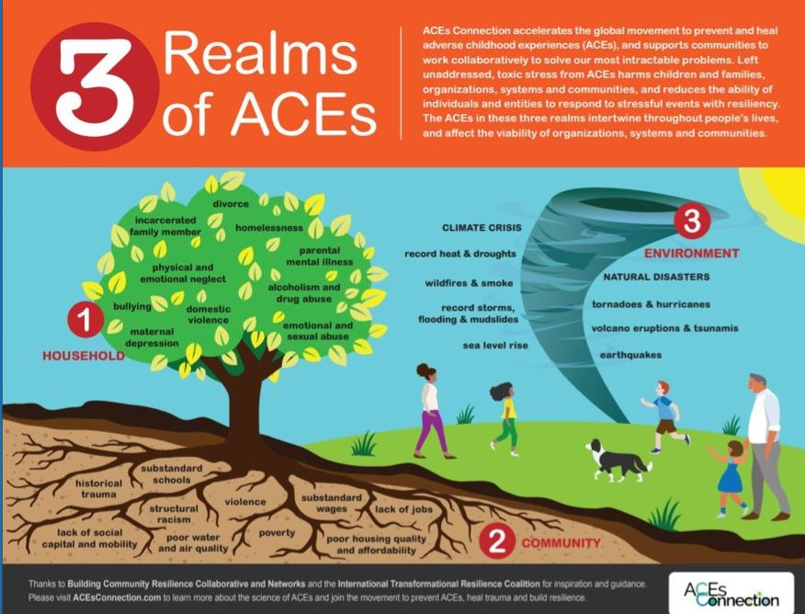
PACEs Science
Epidemiology ACE Study and expanded ACE surveys.
Impact on the brain toxic stress caused by ACEs changes structure and function of brain.
Impact on the body health consequences of toxic stress (short & long term)
Epigenetics how toxic stress from ACEs is passed from generation to generation, aka historical trauma.
Resilience brain and body can heal with healthy relationships, healthy organizations, healthy systems, and healthy communities.
Notes:
PACEs science is at the foundation of all we do. If individuals, organizations, systems and communities hope to solve their most intractable problems, they will want to integrate practices and policies based on PACEs science into every organization in every community.
There are five parts to the science of positive and adverse childhood experiences: The burden of childhood adversity on individuals, organizations, systems and communities. The impact of toxic stress from ACEs on the brain. How toxic stress from ACEs damage our health. How toxic stress from ACEs is passed on from generation to generation, and in systems through decades. And how the brain and body can heal through using positive childhood experience, and how we can prevent ACEs.

Slide 3
Supporting communities to accelerate the use of PACEs science…to solve our most intractable problems.
PACEs = positive and adverse childhood experiences
PACEs Connection
Notes:
We at PACEs Connection support communities to accelerate the use of ACEs science…
...to solve our communities’ most intractable problems.

Slide 4
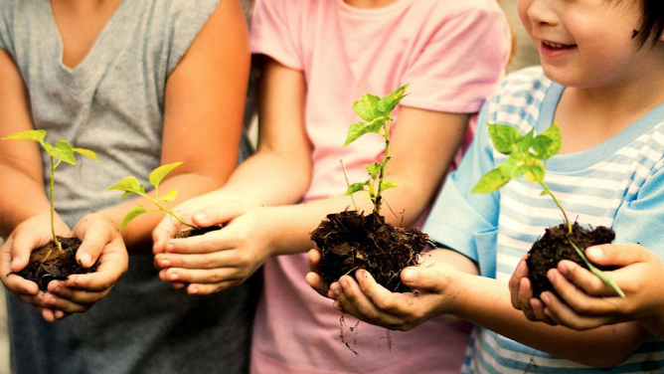
WHAT WE DO
Connect with support.
We support community PACEs initiatives to create solution-oriented systems.
450+
CITIES, COUNTRIES & STATES
…use free community site, tools,
guidelines on PACEs Connection
Notes:
The people and communities who participate in PACEs Connection learn about these new practices and policies, and use them in their own organizations and communities. When they make improvements, they share that with the rest of the PACEs community.

Slide 5

The social network
for the PACEs movement.
WHO WE ARE
57,500+
MEMBERS (AND GROWING)
…who share best practices
based on PACEs science.
Notes:
This is why individuals, organizations, systems and communities integrate healing-centered, trauma-informed practices based on PACEs science:
Many schools don’t need to suspend or expel students anymore. In fact, our story about Lincoln High School in Walla Walla, WA, led to the making of the documentary Paper Tigers, after our story went viral with more than 800,000 page views.
A health clinic in Pueblo, Colorado, saw a 30 percent drop in visits to the emergency room.
In San Diego, during the first year of a juvenile detention facility built to be trauma-informed from the ground up, there were no violent incidents whatsoever.
Pediatricians detect developmental problems and identify family violence years earlier to prevent lasting damage.
After one year, family courts that integrated the Safe Babies Courts approach saw 99 percent of the kids suffer no further abuse.
A family physician in Tennessee who treats people addicted to opioids showed that 99 percent of his patients were able to hold down a job, which is the best indicator of healing.
Within 24 to 48 hours after a person recovers from an opioid overdose in Plymouth County, MA, a police officer visits and offers to take them to a rehab facility right then and there. And then says, “How about I treat you to dinner on the way?” Opioid deaths in the county dropped 26 percent, while in the surrounding counties, death rates increased 84%.
A batterer intervention program in Bakersfield, CA, saw recidivism rates fall from 60 percent to 1 percent.
The Wisconsin Economic Development Corporation found that staff turnover declined from 21 percent to just 10 percent.
In Cowlitz County, WA, youth suicide and suicide attempts dropped 98 percent.

Slide 6




PACEs: Positive and Adverse Childhood Experiences
PACEs Connection is the
hub for the PACEs movement.
We are accelerating the use of PACEs science to solve our most intractable problems by sharing best practices and building relationships.
We educate
people about PACEs science.
We connect
individuals, organizations and communities with each other.
We support
430+ communities and 55,000+ members.
Notes:
PACEs Connection is the hub for the movement spreading the science of positive and adverse childhood experiences or PACEs. PACEs Connection is a social network that offers education, connection and support. We are a community of 400 + communities working together to solve our most intractable problems.

Slide 7

Questions: CommunityManager@pacesconnection.com
How do you get involved?
Join PACEs Connection for free
Sign up for our Creating Resilient Community Accelerator Program, in which we provide FREE PACEs science education
Attend an upcoming webinar to learn more about our work
1.
Become a Member
Find a PACEs initiative in your community
No initiative in your location or focus area? We can help you start a community!
2.
Join an Initiative
Notes:
So how can you get involved?
Membership is free and open to the public! https://www.pacesconnection.com/join
Our creating resilient communities accelerator program is a 16 hour course on PACEs science that is open to the public. New cohorts start every week so join now - https://www.pacesconnection.com/pages/CRC
We host many different webinar series throughout the year including our Historical Trauma Series (https://www.pacesconnection.com/blog/paces-connection-presents-the-historical-trauma-in-america-series?fbclid=IwAR3LrIjFCFBAv1v_h63P7V-Dz5ZGdTjhBlSYwxs4Svv9Y7FrgOx3wZQ5aXA) or you can check out other webinars on our Eventbrite page - https://www.eventbrite.com/o/paces-connection-33705930403
You can get involved with your local PACEs initiative by finding a community near where you live or one that focuses around a topic area that you’re interested in! https://www.pacesconnection.com/blog/communities-on-paces-connection-by-interest-and-location
No initiative near you? We at PACEs Connection would be happy to support you in starting one! https://www.pacesconnection.com/blog/organizing-your-aces-initiative-steps-to-growing-a-resilient-community

