Slide 1
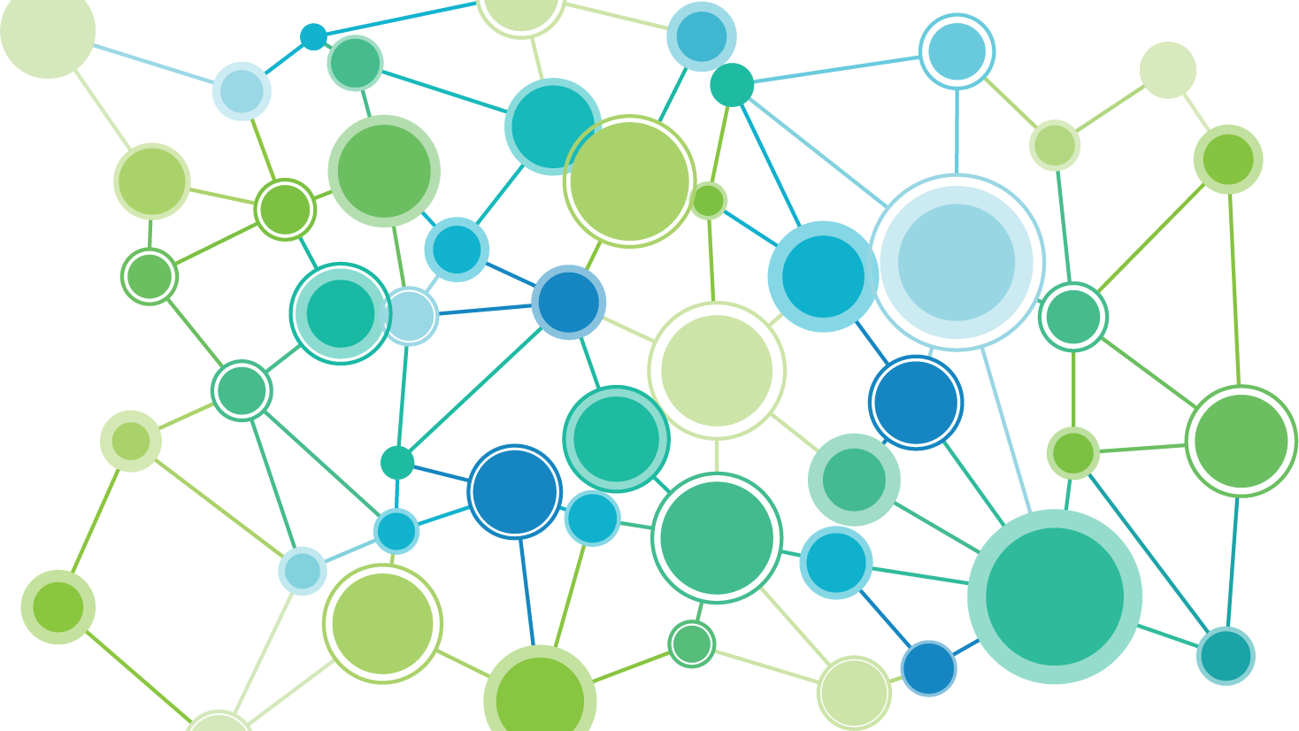
PACEs Science Overview

Slide 2
PACEs Connection
Creating a much better normal.
PACEs Science Overview
Jane Stevens, Founder & Publisher jstevens@pacesconnection.com
Notes:
Welcome to this presentation about the science of positive and adverse childhood experiences—PACEs science. This presentation was put together by PACEs Connection. We’re dedicated to creating a better normal—one in which we solve our most intractable problems. Our social network PACEsConnection.com has tens of thousands of members, and we support hundreds of PACEs initiatives that are creating healthy communities. We educate people and organizations about PACEs science, connect people and organizations with each other to avoid re-inventing the wheel, and tell stories to advance the PACEs movement and the integration of practices and policies based on PACEs science.
At this point, all of you have probably heard something about ACEs—adverse childhood experiences—or PACEs—the science of positive and adverse childhood experiences. This knowledge is changing everything. It pulls together and weaves into a mighty movement the threads of changes that have been attempted in many sectors for generations.

Slide 3
Blame, shame and punishment
to understanding,
nurturing, and healing
Notes:
At the crux of this movement are two very simple, but important concepts:
To change all of our practices and policies to move from blame, shame and punishment….to understanding, nurturing and healing.

Slide 4
Knowing about PACEs science changes what people believe about themselves.
We weren’t born bad.
We weren’t responsible for the things that happened to us when we were children.
We coped appropriately, given that we were offered no other ways – it kept us alive.
We can change.
Notes:
Second, it fundamentally changes what people believe about themselves, resulting in a mind shift about how we see ourselves and the world.
We weren’t born bad.
We weren’t responsible for the things that happened to us when we were children.
We coped appropriately, given that we were offered no other ways — it kept us alive.
We can change.
You can also say this about families, organizations, communities and nations. For example, a traditional child welfare organization that is integrating PACEs science can say:
Our organization began with hope and optimism.
It wasn’t responsible for the environment in which it was created.
It coped appropriately, given the restraints put on the organization.
We can change the organization and the environment.

Slide 5
Supporting communities to accelerate the use of PACEs science to solve our most intractable problems.
PACEs = Positive & Adverse Childhood Experiences
PACEs Connection
Notes:
There’s no question that PACEs science is the foundation to understanding and eliminating our most intractable problems.
We’re seeing examples of this every day:
Many schools don’t need to suspend or expel students anymore.
A health clinic in Pueblo, Colorado, saw a 30 percent drop in visits to the emergency room.
In San Diego, during the first year of a juvenile detention facility built to be trauma-informed from the ground up, there were no violent incidents whatsoever.
After one year, family courts that integrated the Safe Babies Courts approach saw 99 percent of the kids suffer no further abuse.
A family physician in Tennessee who treats people addicted to opioids showed that 99 percent of his patients were able to hold down a job, which is the best indicator of healing.
Within 24 to 48 hours after a person recovers from an opioid overdose in Plymouth County, MA, a police officer visits and offers to take them to a rehab facility right then and there. And then says, “How about I treat you to dinner on the way?” Opioid deaths in the county dropped 26 percent, while in the surrounding counties, death rates increased 84%.
A batterer intervention program in Bakersfield, CA, saw recidivism rates fall from 60 percent to from 1 to 6 percent.
The Wisconsin Economic Development Corporation found that staff turnover declined from 21 percent to just 10 percent.
In Cowlitz County, WA, youth suicide and suicide attempts dropped 98 percent.
A home visiting program in Sonoma County, CA, that educates parents about PACEs science and provides information on how to incorporate positive experiences in their lives resulted in reaching 80 to 100 percent of their goals, including families acquiring health insurance, regular access to medical care (including pre-natal care), childhood immunizations, treatment for mental depression and early intervention for developmental delays.
Name a sector, and there’s an example of people making a difference.

Slide 6
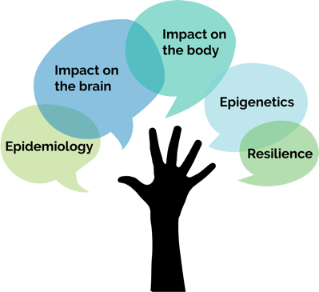
5 parts of PACEs science
Epidemiology. ACE Study, expanded ACE surveys, PACEs surveys
Impact on the brain. Toxic stress caused by ACEs impact children’s developing brains.
Impact on the body. Short and long-term health consequences of toxic stress.
Epigenetics. How toxic stress is passed from one generation to another; historical trauma.
Resilience. The brain is plastic. The body wants to heal.
Notes:
There’s no doubt that the CDC Kaiser Permanente Adverse Childhood Experiences Study is an easy door to go through to begin to explore the mind-bending, world-changing knowledge of PACEs science, but there was much more going on before, during and after the ACE Study was first published. The story of that evolution is for another time. For this presentation, it’s important to know that around 2012, PACEs science jelled into what it is today — an interlocking matrix of five areas of complementary research:
The ACE Study and subsequent ACE surveys that show how many people experience ACEs, at what levels, and the consequences (epidemiology).
How toxic stress from ACEs damages children’s developing brains (neurobiology or brain science).
How toxic stress from ACEs affects our short- and long-term health.
How we pass ACEs from generation to generation through our genes (epigenetics)and systems (historical trauma).
And how resilience research shows that our brains are plastic (malleable) and our bodies can heal by experiencing positive childhood experiences (PCEs) during childhood and resilience-building practices based on PACEs science, and as adults through practices that build resilience, such as exercise, therapy, being in nature, interacting with close and healthy friends, sleeping enough, eating nutritious foods, living in a safe place, having employment with a good wage and/or volunteering. All people deserve to live this way.
I’ll go over each one of these in detail.

Slide 7
PACEs Science
Epidemiology
Adverse Childhood Experiences Study (ACE Study)
In the 1990s, two doctors stumbled into what would become one of the most significant public health discoveries of a generation.
Notes:
Let’s look at the ACE Study in a little more detail. In the 1990s, two physicians stumbled onto what would become one of the most significant public health discoveries of a generation.
Source: Felitti VJ et al (1998) Relationship of childhood abuse and household dysfunction to many of the leading causes of death in adults. The adverse childhood experiences (ACE) study. American Journal of Preventative Medicine; 14: 4, 245-258.

Slide 8
Original ACE Study, published in 1998
Adverse Childhood Experiences Study (ACE Study)
The Centers for Disease Control (CDC) and Kaiser Permanente in San Diego tracked the health
outcomes of 17,300 adults based on their childhood trauma.
75%
They all had jobs and great health care
(median age 57 yr. old)
39%
36%
White
College graduate
Some college
Notes:
More than 17,000 adults participated in the ACE Study. They were mostly White, most attended college, and all had jobs and great health care, because they were members of the Kaiser Permanente healthcare system San Diego.

Slide 9
Original ACE Study – 10 Questions
What are the Adverse Childhood Experiences?
Child physical abuse
Child sexual abuse
Child emotional abuse
Physical Neglect
Emotional Neglect
6) Mentally ill, depressed or suicidal person in the home
7) Drug addicted or alcoholic family member
8) Witnessing domestic violence against the mother
9) Loss of a parent to divorce
10) Incarceration of any family member
Notes:
POLL: [Do this anonymously through an online program such as PollEverywhere, where a group’s burden of ACEs can be seen. Do NOT do this by people raising their hands.]
How many ACEs do you have?
1-2
3-4
5+

Slide 10
ACE Study Key Findings
Direct link between childhood trauma and the adult onset of chronic disease, as well as mental illness, social and economic problems.
About two-thirds of participants experienced one or more types of adverse childhood experiences (ACEs). Of those, 87 percent had experienced 2 or more types. In other words, ACEs usually don’t happen in isolation.
Dose-dependent outcomes: More ACES result in a higher risk of medical, mental, social and economic problems as an adult.
Notes:
There’s a direct link between childhood trauma and the adult onset of chronic disease, as well as mental illness, social and economic problems.
About two-thirds of participants experienced one or more types of adverse childhood experiences (ACEs). Of those, 87 percent had experienced 2 or more types. In other words, ACEs usually don’t happen in isolation. (To clarify, two experiences of sexual abuse are an ACE score of 1. Experiencing any number of physical abuse events and any number of verbal abuse events is an ACE score of two.)
The outcomes are dose-dependent: More ACEs result in a higher risk of medical, mental, social and economic problems as an adult.

Slide 11
ACE Study
Findings
Notes:
Small dots show small risk. Large dots show increased risk. As you can see, things start getting serious around an ACE score of 4.

Slide 12
Impact of ACE Score of 4 or more
Health Behaviors
Mental Health
10.3 times more likely to use injectable drugs
7.4 times more likely to be an alcoholic
3.3 times more likely to engage in risky sexual behavior
3.23 times more likely to binge drink
2.93 times more likely to be a current smoker
12.2 times more likely to attempt suicide
5.13 times more likely to suffer from depression
4.22 times more likely to be diagnosed with dementia
Notes:
Here’s another slide that shows how more ACEs increase the risk of a variety of health and mental health behaviors. Later, I’ll show how that affects physical health and increases chronic disease.
Compared with people with zero ACEs, those with 4 types of were twice as likely to be smokers, 12 times more likely to have attempted suicide, and 7 times more likely to be alcoholic.
People with high ACE scores are more likely to be violent, to have more marriages, more broken bones, more drug prescriptions, more depression, more auto-immune diseases, and more work absences.
A grim note: Without intervention, those with 6 or more ACEs have a lifespan that’s 20 years shorter than those with zero ACEs.

Slide 13
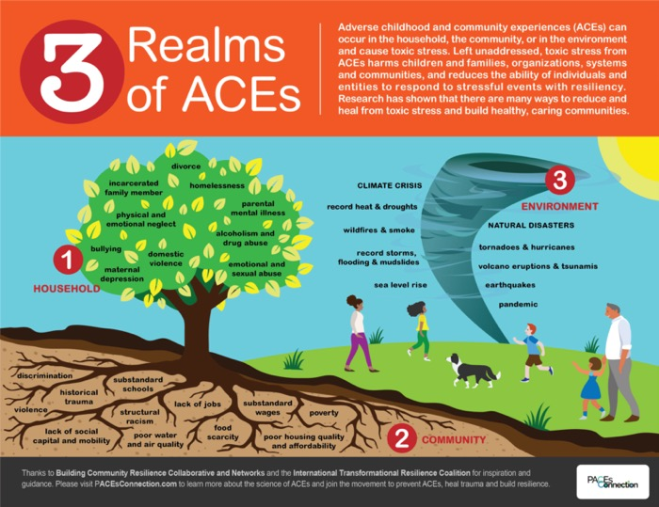
Notes:
Here are a few misconceptions about PACEs science.
The two biggest are:
That it’s just about the 10 ACEs in the ACE Study — the CDC-Kaiser Permanente Adverse Childhood Experiences Study. It’s about sooooo much more than that.
And that it’s just about ACEs…adverse childhood experiences.
These two myths are intertwined. The ACE Study issued the first of its 70+ publications in 1998, and for many people it was the lightning bolt, the grand “aha” moment, the unexpected doorway into a blazing new understanding of the link between childhood adversity and the adult onset of chronic disease, mental illness, violence and being a victim of violence, among many other surprising consequences. By the way, Anda and Felitti recognized that there were many other ACEs than those they chose to look at — including racism, bullying, a father being abused, and community violence. They settled on those 10 because they were identified as common in a pilot study of about 300 people; several of the adverse experiences — such as sexual abuse and physical abuse — had been individually well studied.
Since the original ACE Study was done, there have been many other surveys and studies, and many of those have expanded the types of ACEs. Based on the other parts of ACEs science, we now know that any experience that results in sustained toxic stress can be regarded as an ACE. So, we put together this infographic to show the three realms of ACEs:
Family
Community
Environment
The experiences listed in the three areas in the infographic can all harm children’s brains and bodies. How they recover — or cope — depends on the supports provided them during and after the experience.

Slide 14
Notes:
Another misconception:
Physical and sexual abuse are the worst ACEs. The reality is this: The brain, for the most part, doesn’t distinguish between different types of ACEs — once the experience goes into the brain, it’s all toxic stress. The ACE Study showed that — on a population level — it doesn’t matter what the types of ACEs are. An ACE score of 4 that includes divorce, physical abuse, an incarcerated family member and a depressed family member has the same statistical outcome as an ACE score of 4 that includes living with an alcoholic, verbal abuse, emotional neglect and physical neglect.
“We studied a whole range of outcomes — emotional, social, financial, biomedical, etc. If someone had an ACE score of 2 or 4 or 7, it didn’t matter how you made the ACE score up. It didn’t matter. That was unexpected and a surprise,” says Felitti.
That’s why a whac-a-mole approach will never work to solving our most intractable problems. The ACE Study showed that if you have onetype of ACE, you’re likely have another. A growing segment of the population has three or more ACEs. Many people and organizations believe that if you prevent one type of child abuse—domestic violence, child sex abuse, verbal abuse, physical violence, etc.—then that type of abuse can disappear with enough time, effort and funding. But, since the families and children with the most problems are dealing with many ACEs, trying to reduce child sex abuse alone won’t address the consequences of the other types of ACEs. Also, reducing one type in one child doesn’t mean that the abuse won’t appear when that child becomes a parent and inadvertently passes on the abuse.
For example, says Felitti: “Although violence can beget violence, it’s hardly the only cause of violence. Basically, there’s lots of other ways: Humiliating people. Isolating people. Verbally provoking them. All of those have potential for producing violence in response.” In addition, violence can provoke nonviolent behavior that can be just as damaging as violence.
So, we can’t expect to eliminate physical abuse if we focus only on physical abuse. We can’t expect to eliminate domestic violence if we focus only on domestic violence. We have to focus on educating hearts, minds, organizations, systems and communities about PACEs science and implementing healing-centered policies and practices.

Slide 15
5 parts of ACEs science
Epidemiology. ACE Study and expanded ACE surveys
Impact on the brain. Toxic stress caused by ACEs impact children’s developing brains.
Impact on the body. Short and long-term health consequences of toxic stress
Epigenetics. How toxic stress is passed from one generation to another; historical trauma
Resilience. The body can heal. Brain is plastic
Notes:
Here’s another very important misconception:
You don’t need to learn about PACEs science if you’re becoming trauma-informed. We know organizations that skip over the ACE Study, include a little bit of brain science, and go right to implementing trauma-informed practice. But with that approach, an organization won’t be as successful as it could be if it integrated PACEs science. Being PACEs-science informed is the bedrock, the foundation of becoming trauma-informed. You need both. PACEs science is the WHAT and WHY. Trauma-informed is the HOW. If we do only the how, becoming trauma-informed risks becoming a fad, especially if implementing trauma-informed practices without PACEs science shows only slight improvement.
The progression for understanding this new knowledge usually goes like this:
Wow, this is familiar. It explains my life.
I wonder how this affects my family & friends?
If most people experience ACEs (and positive childhood experiences, for which I’ll provide more information soon), then that means that most in my organization have, too. How is this affecting them as they interact with their co-workers and their family members?
Since our systems are based on how we understand human behavior, then we need to rethink how our systems interact with the people they serve, educate, imprison, etc.
Some people may be scared when they first learn about PACEs science. It may bring up bad memories, to the point that they can become lost in the memory of a trauma and can no longer pay attention, to going as far as dissociating, which looks as if they’ve fallen asleep. That’s why it’s important when teaching this in a group, to recognize that these responses may occur, they’re normal, and to provide an opportunity for people who feel scared or upset to talk with someone about what they’re feeling. It’s also a reason for providing this information more than one time. If someone’s recalling a traumatic event, their thinking brain automatically goes offline and will not absorb or remember anything about the presentation. More about that in the next slide.
Leaders of organizations sometimes find the knowledge threatening. A point of caution and understanding: If the leaders in an organization don’t integrate the understanding of PACEs science into their own lives and in their workplace, they will not be successful to become a truly trauma-informed organization.
So, onto the other parts of PACEs science: Next is how stress, and toxic stress, affect the brain.

Slide 16
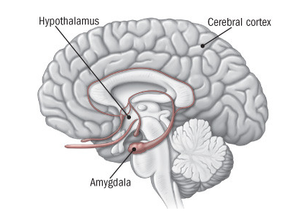
Notes:
If a car comes at you, or you hear gunshots or other danger appears, your eyes, ears or both send a danger alert to your amygdala. Before the rest of your brain registers the danger, your amygdala instantly assesses sounds and sights, and screams DANGER! to the hypothalamus.
The hypothalamus is like a command center for danger. It instantly sends a message to the adrenal glands: START PUMPING ADRENALINE! This triggers a burst of energy for you to fight, run away or freeze. Your heartbeat accelerates. It pushes blood to the muscles and vital organs. Your pulse rate and blood pressure go up. You start to breathe faster. Small airways in the lungs open wide to take in as much oxygen as possible. Your lungs send extra oxygen to the brain, making you more alert. Your sight, hearing, and other senses become sharper. Meanwhile, epinephrine triggers the release of blood sugar (glucose) and fats from temporary storage sites in the body. These nutrients flood into the bloodstream, supplying energy to all parts of the body. (Sympathetic nervous system.)
Source: Harvard Health Publishing —https://www.health.harvard.edu/staying-healthy/understanding-the-stress-response

Slide 17
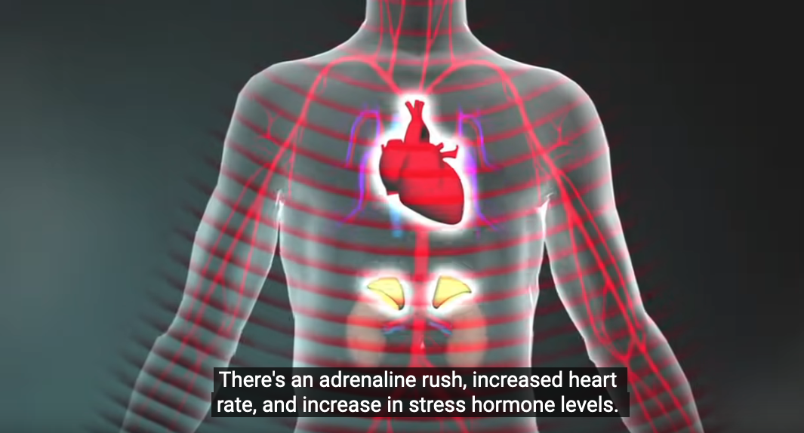
Notes:
All this happens so quickly that you don’t even know that it’s happening. That’s why you can jump out of the way of a car or run from a dog or a bear before you can even think about what you’re doing.
After the initial surge, and the danger has not passed, the hypothalamus activates the second part of the stress response system to keep the gas pedal down. This tells the adrenal glands to release cortisol so the body can stay revved up.
After the danger has passed, the hypothalamus stops telling the adrenal glands to pump adrenaline and cortisol to put the brakes on. (Parasympathetic nervous system.)
But, as Dr. Nadine Burke Harris has said, “What if the bear comes home drunk every night and the stress is constant?” That’s when stress becomes toxic.
Source: Harvard Health Publishing —https://www.health.harvard.edu/staying-healthy/understanding-the-stress-response
https://www.youtube.com/watch?v=rVwFkcOZHJw

Slide 18
Notes:
https://www.youtube.com/watch?v=rVwFkcOZHJw

Slide 19
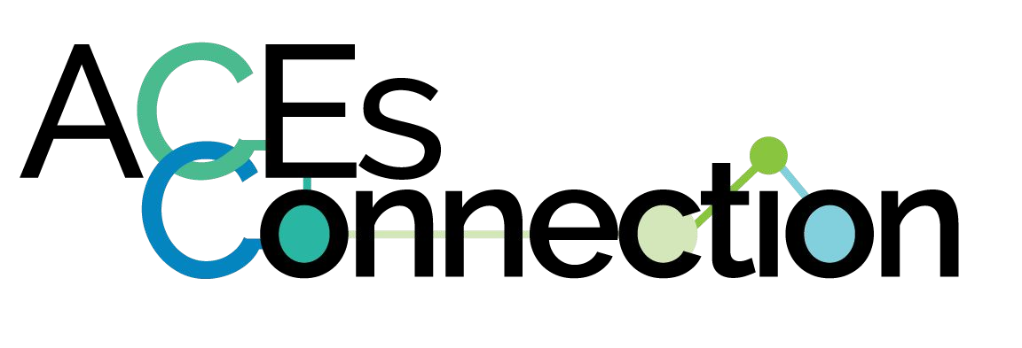
Notes:
Moderate, short-lived stress responses in the body can promote growth. In fact, we need moderate stress to learn and grow.
But toxic stress is the parent who gets drunk several times a week, comes home and beats up a spouse and/or children. Or policies that don’t provide adequate wages, safe housing, good education or access to nutritional food. Or systems that further traumatize already traumatized people, including minorities who constantly face a steady thrum of racism. Or a pandemic.
When there’s unrelenting stress caused by ACEs, and not enough positive childhood experiences—support from an adult caregiver and community and systems policies, this can damage the function and structure of a child’s developing brain, with long-term consequences for learning, behavior, and both physical and mental health.
Source: Center on the Developing Child at Harvard https://developingchild.arvard.edu

Slide 20
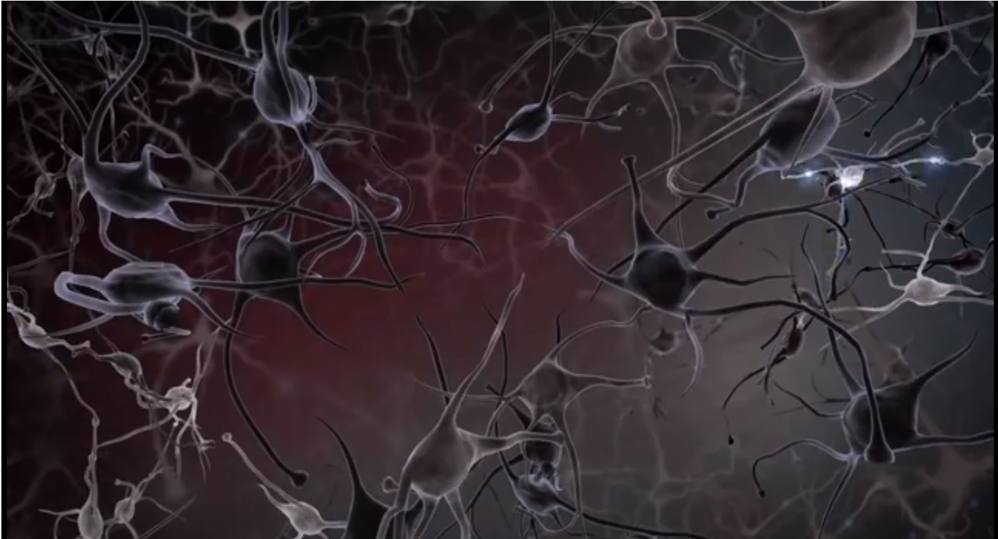
Notes:
This image shows brain cells losing the connections with each other. Essentially, trauma knocks the thinking part of the brain offline, and puts survival brain in charge. This keeps the thinking part of the brain from developing as it should and making strong connections as it learns. If someone is in constant stress, the strongest connections are being made in the part of the brain that reacts to stress.
Children who experience trauma or aren’t provided opportunities to develop attachments to healthy caregivers act out, can’t focus, can’t sit still, withdraw, or dissociate. No amount of reasoning will soothe survival brain. Children are soothed by interacting with a healthy caregiver until they feel safe.
When kids who are continually stressed get older, they cope by drinking, overeating, doing drugs, having inappropriate sex, smoking, etc. What’s really important to understand is that to them, these are coping mechanism; they’re solutions. And they work. Nicotine reduces anxiety. Food soothes. Drugs can be anti-depressants. People who use them often don’t regard them as problems. So, telling someone how bad smoking is for them isn’t likely to change their mind or their behavior.

Slide 21
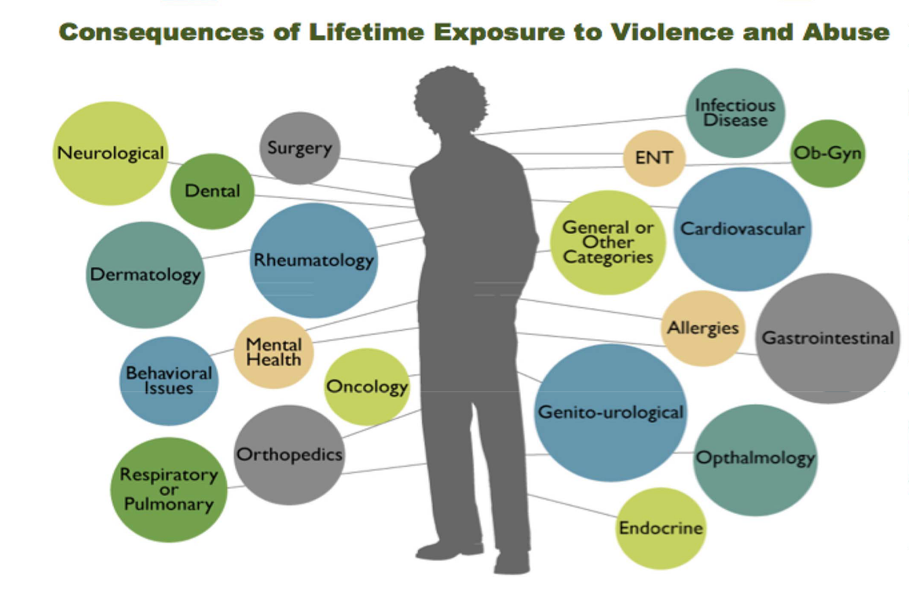
Notes:
Thousands of research publications show that toxic stress during childhood can cause the body to stay in a red alert status, which puts a lot of wear and tear on the body. Too much adrenaline can weaken the heart and lead to Type 2 diabetes. Too much cortisol can lead to arthritis, gastrointestinal disease, depression and shrink lymph nodes. Too little cortisol, which also regulates our immune response, can cause our immune system to attack parts of our body. This can lead to lupus, multiple sclerosis, rheumatoid arthritis and fibromyalgia.

Slide 22
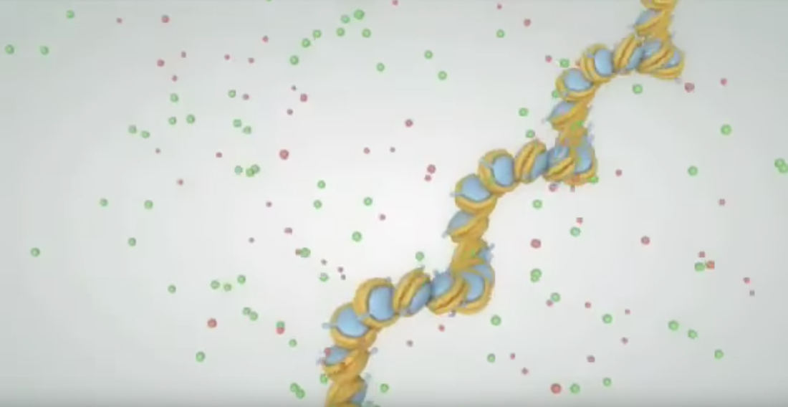
Notes:
Many people think that your DNA provides a blueprint for your life. That’s true for many parts of you, such as eye color or skin color. But our genetics are more complicated and wonderful than that. On top of the genome there’s an epigenome, which turns genes on and off, depending on what’s happening in your environment. Say that you grew up in a war zone. To stay alive, you had to stay alert, and the genes that regulate you staying alert are turned on and stay on for as long as you live in that war zone. But if you move out of that war zone to a safe place, and you don’t need to stay alert, eventually some or many of the genes that regulate you staying alert are turned off.
Changes in your epigenome can be handed down from generation to generation. This can result in generational trauma. Changes can also be ameliorated by integrating positive experiences in childhood. Changes can also occur in adulthood, a concept that is particularly important because many adults don’t think they can heal, and don’t understand that believing it is possible to heal is the first step to healing.
Generational trauma expressed in epigenetic changes goes hand-in-hand with historical trauma—the generational longevity of trauma-inducing systems, including racist policies in the healthcare system, in schools, in economic policies, in banking systems, in housing, in law enforcement, in courts, in voting…the list goes on and on.
https://www.youtube.com/watch?v=bJoYbtqPcaA

Slide 23
Notes:
https://www.youtube.com/watch?v=bJoYbtqPcaA

Slide 24
Notes:
But with all this bad news about how trauma hurts us, there’s good news. Our brains are plastic—they’re malleable; they can change. Our bodies want—are designed— to heal. Resilience research has identified many ways that individuals, families, communities and systems can prevent childhood adversity, integrate positive childhood experiences, stop further traumatizing already traumatized adults, and provide practices and policies that heal. This slide shows the core protective factors for families developed by the Strengthening Families Framework.
Although this research is just beginning, people and organizations across the United States and the world are already working to increase positive childhood experiences and positive adult experiences in themselves, their organizations, their systems and their communities.

Slide 25
Why PACEs?
Because it’s so much more than just
about resilience.
Notes:
Resilience has long been included as one of the five parts of PACEs science. But emerging research shows that positive and adverse childhood experiences are intertwined in a profound way that affects us and how we integrate this science into our work and lives.
I’m going to radically simplify an important aspect of this research and focus on some work by Dr. Christina Bethell and her co-researchers.

Slide 26
7 positive childhood experiences
Able to talk to family about feelings.
Family stood by you during hard times.
Participated in community traditions.
Felt a sense of belonging in high school.
Felt supported by friends.
2 adults (not parents) who took interest in you.
Felt safe, protected by adult in home.
Notes:
So, let’s take a look at that research.
She and others in her research group measured seven positive childhood experiences.
[NOTE: You can add a poll here to see how many PCEs people have.]

Slide 27
High ACEs. You’re not doomed.
Low ACEs. You’re not in the clear.
Notes:
What they found was what you’d expect:
Basically, the more positive experiences you had, the better off you were.
So, a high ACE score doesn’t mean you’re doomed. You may have enough positive childhood experiences to counteract the effects.
But a low ACE score doesn’t mean you’re in the clear. Let’s say you have only one or two ACEs, and only one positive childhood experience. The research shows that you may suffer worse effects than if you had several ACEs.
But it turns out there’s more to the story of ACEs and PCEs and why it’s important to integrate them.

Slide 28
The paradox of PACEs.
The more PCEs, the better. But embrace all the ACEs and PCEs in your life.
People who resist negative emotions are more likely to experience mental health problems.
People who accept their negative feelings and experiences show higher levels of well being and mental health.
Notes:
The more positive childhood experiences (PCEs) you have, your opportunity for a healthy life increases.
But focusing only on PCEs, without acknowledging the ACEs in your life can keep you from flourishing.
Research shows that people who resist negative emotions are more likely to experience mental health problems.
This applies to an individual, as well as a nation. For example, think about how we’re addressing racism and White privilege in this country. Many people say, OK we acknowledge slavery, and now let’s move on. But slavery and its aftermath, such as the Jim Crow era, still affects so many parts of our society, policies, laws, norms and culture that if we’re to heal as a nation, we have to acknowledge and address all of slavery’s generational legacies so that we can develop an equitable and just society in which power is shared.

Slide 29
Notes:
The ongoing goal throughout our lives, through ups and downs, is to flourish. Flourishing means learning skills that emerge from understanding our childhood experiences, which begins with accepting the impacts of both the negative experiences and positive experiences.
There is so much more to this, and there will be, as time goes on. We’ll continue to provide updates to this research in the PACEs Connection Resource Center.

Slide 30
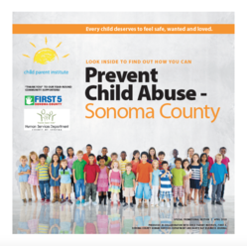
Original ACE Study data vs Helping Professionals ACE survey
Abuse
Psychological
Physical
Sexual
Neglect
Emotional
Physical
Household Dysfunction
Substance Abuse
Parent Absent
Mental Illness
Domestic Violence
Criminal Behavior
11%
28%
21%
15%
10%
27%
23%
17%
13%
6%
53%
23%
28%
25%
12%
51%
46%
47%
16%
9%
Blue Ribbon Event May 2015
Prevalence ACE Study (1998) VS professionals working to prevent child abuse (2015)
Notes:
AND…as I pointed out earlier, it’s critical that organizations acknowledge and examine their own ACEs burden—as well as their foundation of positive experiences—by having each staff member do their own ACE and positive experiences score anonymously, preferably in a group. This slide shows why. We did an anonymous group survey of the audience at this event, which comprised helping professionals in Sonoma County, CA. The high levels of ACEs in health professions were astounding to the group.
It’s important for every organization—whether they are part of the healthcare system or not—to examine their own ACEs and PCEs. If you do this, as mentioned before, some people will vividly recall their childhood trauma, and tune out to what’s happening around them. They may also want to talk with a counselor or peer to process their feelings, so it’s important to announce prior to the presentation that there will be someone to talk with afterwards.

Slide 31
Notes:
Let’s look at two more myths.
Since ACEs only happen during childhood, we should focus all our resources on kids and we’ll solve our problems. Research shows that parents pass their ACEs on to kids, so you have to involve parents, organizations and communities. If parents address their ACEs, learn about PACEs science, and get help, they get healthier, and, as a result, their kids get healthier. If organizations address their ACEs and integrate PCEs, they’re stop retraumatizing their workers, most of whom have ACEs.
What causes ACEs? Toxic stress. And since toxic stress appears in the community and the environment, parents won’t get as healthy as their kids need them to be until the organizations and systems they work for and interact with, the communities they live in, and the nations they’re part of stop traumatizing already traumatized people and start healing.
The early PACEs science pioneers have shown that we can solve our most intractable problems, but we won’t solve our most intractable problems unless all organizations, systems in all sectors, all communities and nations integrate trauma-informed practices based on PACEs science.

Slide 32
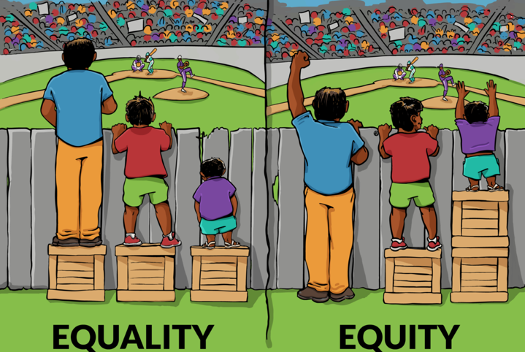
Notes:
The last myth.
We only need to address ACEs in poor people of color, because poor people of color are the demographic with the highest burden of ACEs. This just further exacerbates the them-us situation we’re all in and is short-sighted. ACEs are everywhere, in all demographics. And people in power — which in the United States are mostly tall White men who come from middle-class and upper middle-class backgrounds — can and do act out their ACEs by intentionally or unintentionally abusing people individually and by policies that they create, either in the organizations they lead or the positions they hold in public office. You can find many examples of leaders in the business, faith-based, healthcare, entertainment, political and other arenas who have done so, and are doing so, due to their own ACEs.
So, while we’re doing all we can to get to equity, we need to create our systems so that they address everyone’s ACEs, otherwise, we’ll be playing whac-a-mole here, too.
People, families, organizations, communities and even some systems are beginning to resonate with this remarkable new knowledge of PACEs science.
Now I’m going to tell you a little about how people have responded to this new knowledge about PACEs science to create a remarkable movement that is growing by leaps and bounds.

Slide 33
Notes:
Since 2014, Dr. Nadine Burke Harris’ TED talk—”How childhood trauma affects health across a lifetime”—has been viewed more than 9.4 million times.

Slide 34
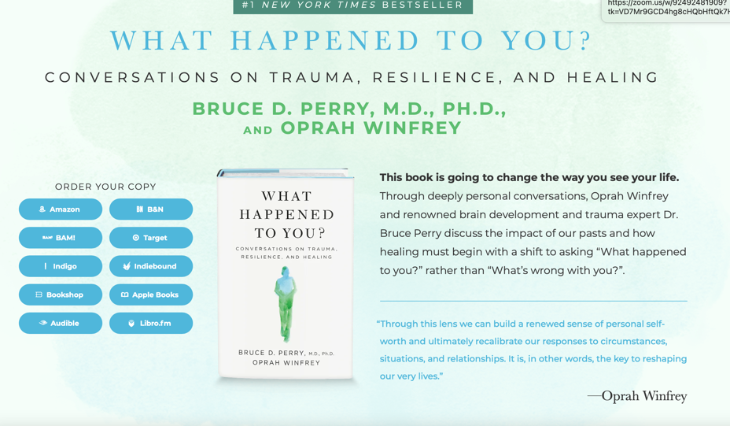
Notes:
This book, What Happened To You? Conversations on Trauma, Resilience and Healing was on the New York Times hardback bestseller list for five months in 2021.

Slide 35
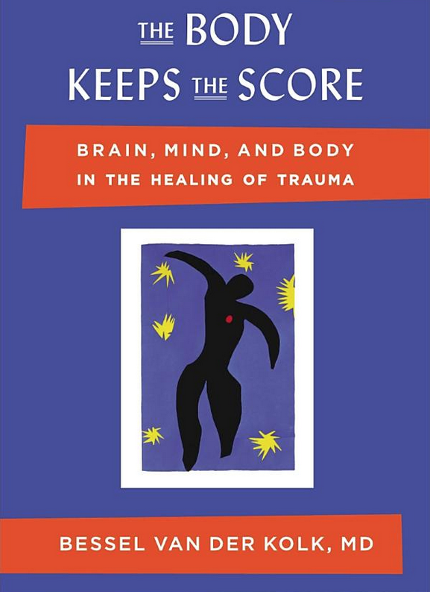
Notes:
As of February 2022, Bessel van der Kolk’s book, The Body Keeps the Score has been on the New York Times paperback top ten bestseller list for more than 170 weeks.

Slide 36
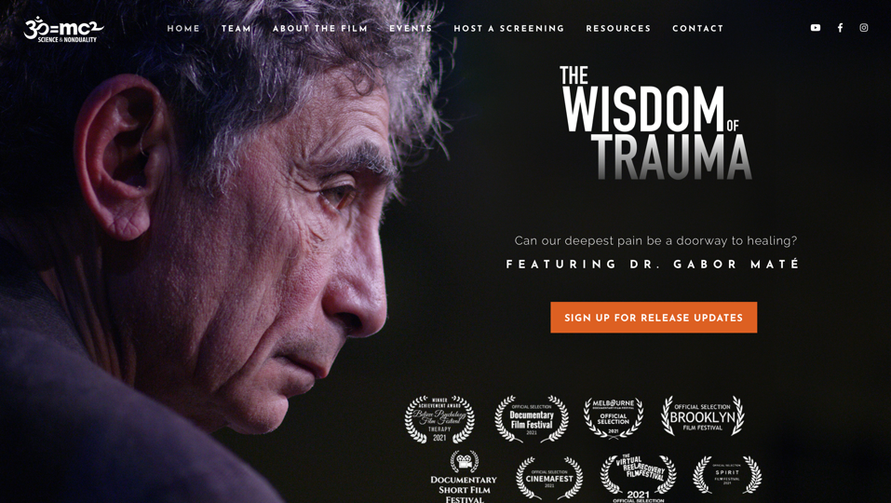
Notes:
In its week-long debut in May 2021, four million people from more than 200 countries watched The Wisdom of Trauma.

Slide 37
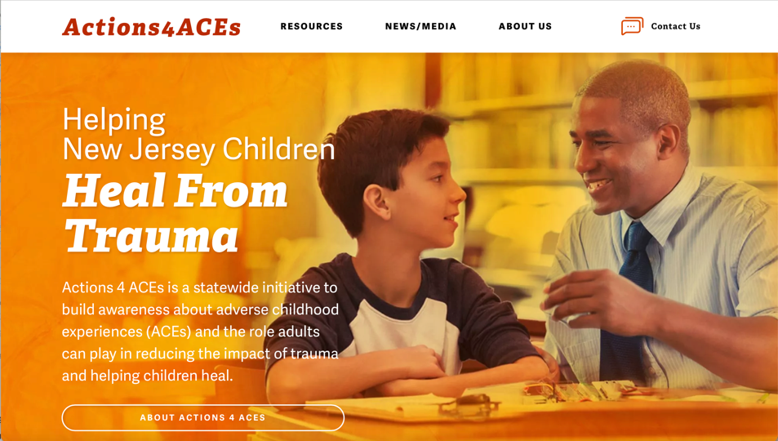
Notes:
Several states have launched PACEs coalitions, including New Jersey, which introduced a statewide ACEs public awareness campaign in 2021.

Slide 38
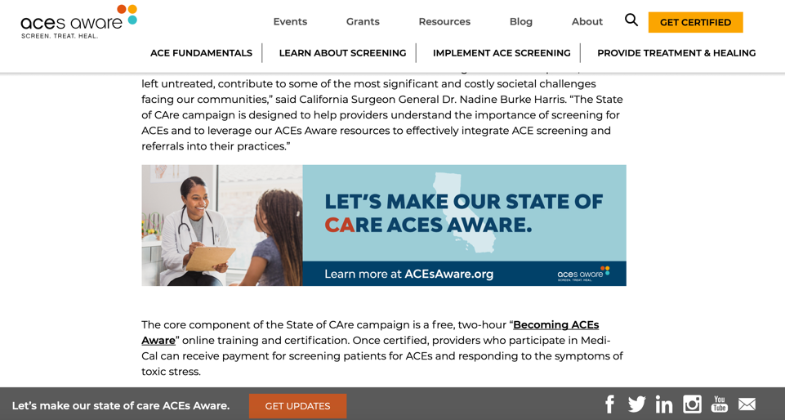
Notes:
California launched a statewide ACEs campaign in 2019 to have every pediatrician and family practice physician in the state screen for childhood adversity.

Slide 39
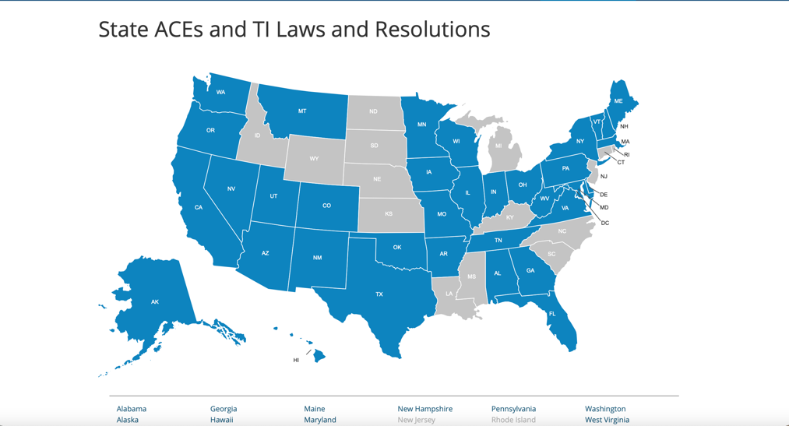
Notes:
In 2019 and 2020, dozens of states enacted nearly 60 laws and resolutions that specially reference adverse childhood experiences (ACEs) or trauma. Since the first ACEs bill passed in Washington State in 2011, over 130 laws and resolutions have passed in 39 states and the District of Columbia, including nine in 2021.

Slide 40
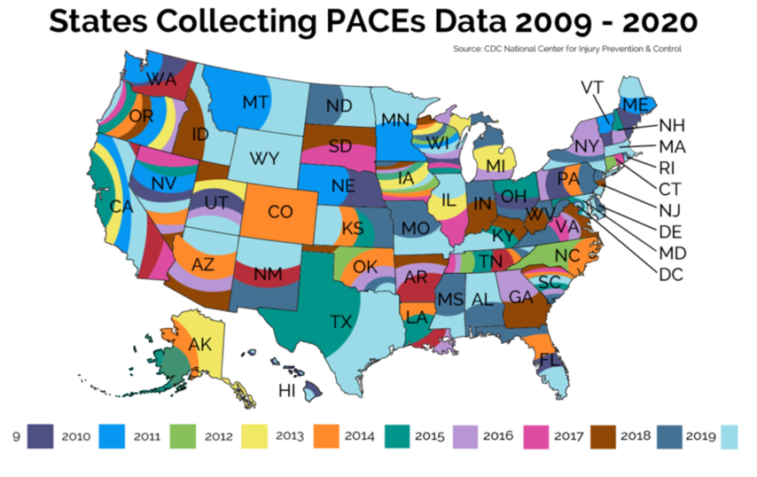
Notes:
Over the last dozen years (2009-2020), every state and the District of Columbia have included the ACEs module in the Behavioral Risk Factor Surveillance System (BRFSS) Survey at least once—many multiple times—achieving a significant milestone in the PACEs (ACEs/trauma/resilience) movement. In 2009, the first year that the ACEs module was available for inclusion in the BRFSS, only Arkansas, California, Louisiana, New Mexico, Tennessee, and Washington participated.
I hope this overview of PACEs science has been informative and useful. It is definitely an overview—there’s so much more to PACEs science, and to the practices and policies based on PACEs science that people are integrating in schools, healthcare, courts, law enforcement, prisons….in any sector, you’ll find pioneers and early adopters who are making great progress in solving our most intractable problems.
You can keep track of developments by joining PACEsConnection.com. It’s free.
You can dive into more details by visiting the PACEs Connection Resource Center. Links to both—as well as the videos and other information—are on the next two slides.
Thank you so much for your interest.

Slide 41
Resources:
PACEs Connection— www.pacesconnection.com
Why PACEs? — www.pacesconnection.com/blog/better-normal-march-26-positive-and-adverse-childhood-experiences-paces-what-happens-in-childhood-matters and www.pacesconnection.com/blog/we-ve-changed-our-name-to-paces-connection
2011-2021— A decade of steady grown in ACEs the TI laws and resolutions in the states. www.pacesconnection.com/blog/2011-2021-a-decade-of-steady-growth-in-aces-and-ti-laws-and-resolutions-in-the-states
Understanding the Stress Response — www.health.harvard.edu/staying-healthy/understanding-the-stress-response (Harvard Health Publishing)
Notes:
Links:
PACEs Connnection— www.pacesconnection.com
Why PACEs? — www.pacesconnection.com/blog/better-normal-march-26-positive-and-adverse-childhood-experiences-paces-what-happens-in-childhood-matters and www.pacesconnection.com/blog/we-ve-changed-our-name-to-paces-connection
2011-2021— A decade of steady grown in ACEs the TI laws and resolutions in the states. www.pacesconnection.com/blog/2011-2021-a-decade-of-steady-growth-in-aces-and-ti-laws-and-resolutions-in-the-states
Understanding the Stress Response — www.health.harvard.edu/staying-healthy/understanding-the-stress-response (Harvard Health Publishing)

Slide 42
PACEs Connection Resource Center — https://pacesconnection.libguides.com/resourcecenter
Pitchfork Economics — https://pitchforkeconomics.com/
Positive Childhood Experiences and Adult Mental and Relational Health in a Statewide Sample: Associations Across Adverse Childhood Experiences Levels. Bethell C, Jones J, Gombojav N, Linkenbach J, Sege R. JAMA Pediatr. 2019 Nov 1;173(11):e193007. doi: 10.1001/jamapediatrics.2019.3007. Epub 2019 Nov 4. https://pubmed.ncbi.nlm.nih.gov/31498386/
Dr. Nadine Burke Harris TED Talk — https://www.ted.com/talks/nadine_burke_harris_how_childhood_trauma_affects_health_across_a_lifetime?language=en
Stress response video — https://www.youtube.com/watch?v=rVwFkcOZHJw
Epigenetics video — https://www.youtube.com/watch?v=bJoYbtqPcaA
Notes:
PACEs Connection Resource Center — https://pacesconnection.libguides.com/resourcecenter
Positive Childhood Experiences and Adult Mental and Relational Health in a Statewide Sample: Associations Across Adverse Childhood Experiences Levels. Bethell C, Jones J, Gombojav N, Linkenbach J, Sege R. JAMA Pediatr. 2019 Nov 1;173(11):e193007. doi: 10.1001/jamapediatrics.2019.3007. Epub 2019 Nov 4. https://pubmed.ncbi.nlm.nih.gov/31498386/
Dr. Nadine Burke Harris TED Talk — https://www.ted.com/talks/nadine_burke_harris_how_childhood_trauma_affects_health_across_a_lifetime?language=en
Stress response video — https://www.youtube.com/watch?v=rVwFkcOZHJw
Epigenetics video — https://www.youtube.com/watch?v=bJoYbtqPcaA

Slide 43
PACEs Connection
Creating a much better normal.
Join PACEs Connection!
Go to www.pacesconnection.com
Notes:
Thank you!

